Slide 1
Callbacks In Java Script
RollNo-22h51a05b1
CSE-D

Slide 2
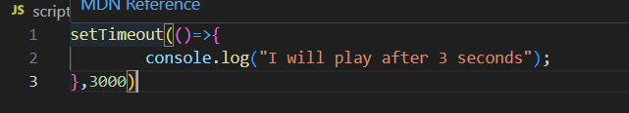
Asynchronous actions
Asynchronous JavaScript is a programming approach that enables the non-blocking execution of tasks, allowing concurrent operations, improved responsiveness, and efficient handling of time-consuming operations in web applications, JavaScript is a single-threaded and synchronous language. The code is executed in order one at a time, But Javascript may appear to be asynchronous in some situations.

Slide 3
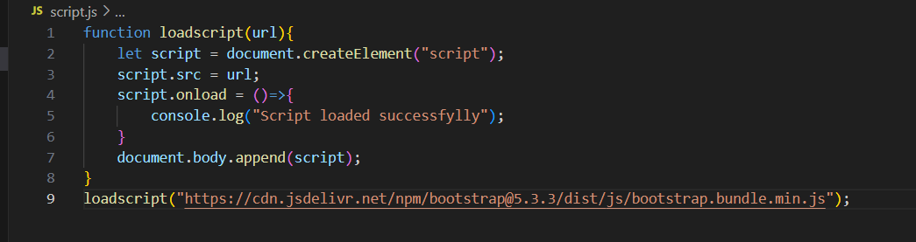
Introduction to Callbacks
Callbacks are functions that are passed as arguments to other functions.
1
Notes:
Image source: https://www.achieversit.com/callbacks-in-javascript

Slide 4
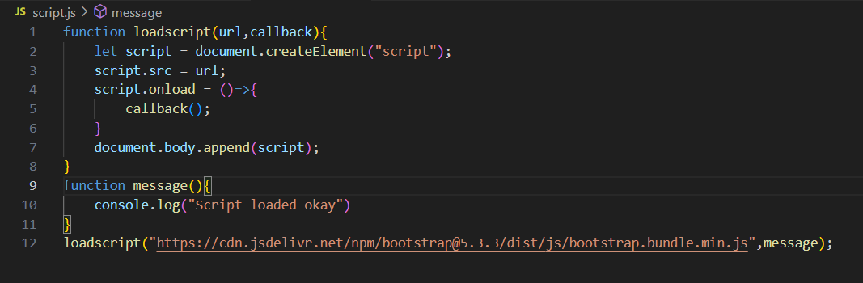
What is a Callback?
A callback is a function that is invoked after another function has completed its execution.
2
Notes:
Image source: https://www.achieversit.com/callbacks-in-javascript

Slide 5
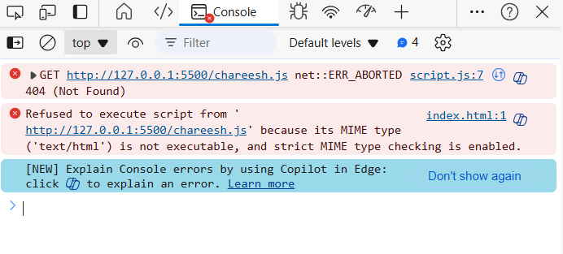
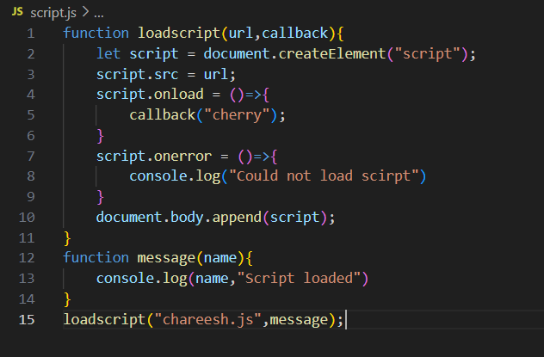
Error handling
3
Notes:
Image source: https://lovebleeding9ffedd.blogspot.com/2021/07/41-asynchronous-and-synchronous.html

Slide 6
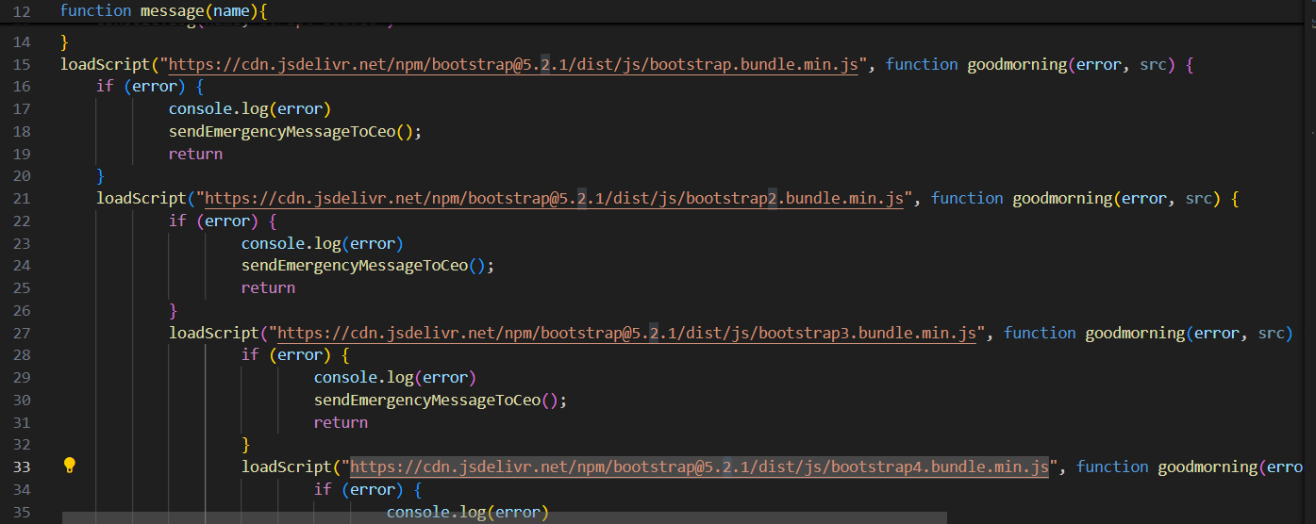
Callback Hell
Callback hell refers to the situation where multiple nested callbacks make code difficult to read and maintain.
7
Notes:
Image source: https://blog.termian.dev/posts/escaping-the-callback-hell-in-vertx/

Slide 7
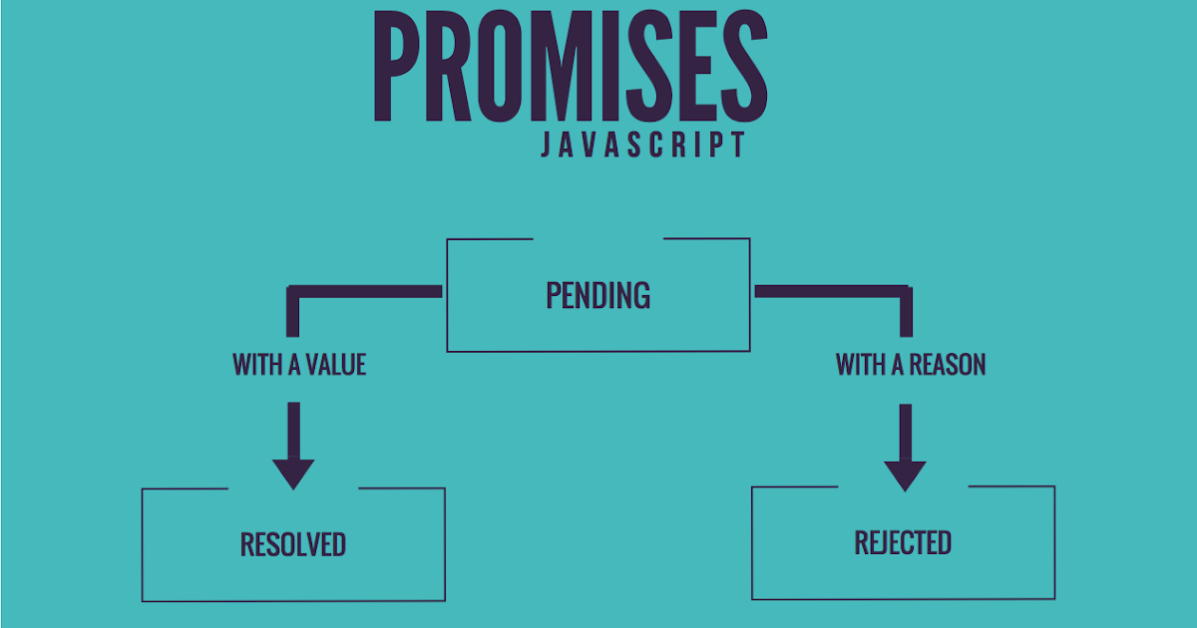
Promises as an Alternative
Promises provide a more manageable way to handle asynchronous operations compared to callbacks.
They allow chaining of operations and help avoid callback hell by returning a value that can be processed later.
Understanding promises is important as they are a foundational concept leading to async/await in JavaScript.
8
Notes:
Image source: http://www.thedevnotebook.com/2017/02/javascript-promises.html

Slide 8
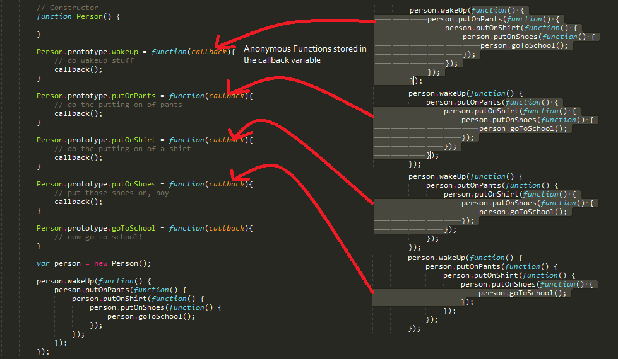
Conclusion
Callbacks are a powerful feature in JavaScript that enable asynchronous programming.
While they can lead to complex code structures like callback hell, understanding their use is crucial.
With the advent of promises and async/await, callbacks have evolved, but their foundational role remains important.
10
Notes:
Image source: https://khalilstemmler.com/articles/how-to-easily-understand-callbacks-in-javascript/

Slide 9
THANK YOU

